Slide 1
The Art of Visual Storytelling in UI
By Soumya Ranjan Panigrahy

Slide 2
Project overview
To design a homepage for an e-commerce mobile application that is visually engaging, accessible, and user-friendly. This project will help me to apply UI/UX fundamentals, including visual hierarchy, typography, color theory, spacing, and accessibility, to create a compelling first impression that enhances user engagement.
Platform: Mobile (iOS/Android)
Focus: Usability, aesthetics, and product discoverability.

Slide 3
User Problem Statement
Users face overwhelming product listings.
Navigation is unintuitive in many shopping apps.
Lack of personalization and visual engagement

Slide 4
Design Goals
Simplify product discovery.
Maintain high visual engagement.
Ensure intuitive and fast navigation.
Deliver a seamless mobile-first experience.

Slide 5
Target Users
Age Group: 18–35 years
Urban, tech-savvy users
Expect a personalised and quick shopping experience
Mobile-first shoppers who value speed and design

Slide 6
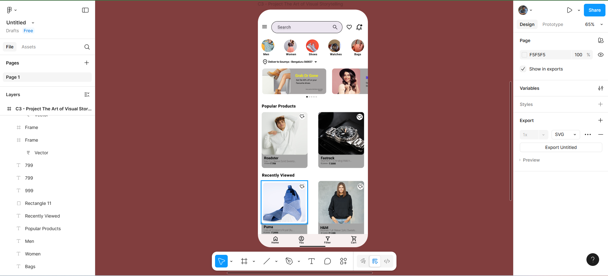
Wireframes / Low-Fidelity Sketch

Slide 7
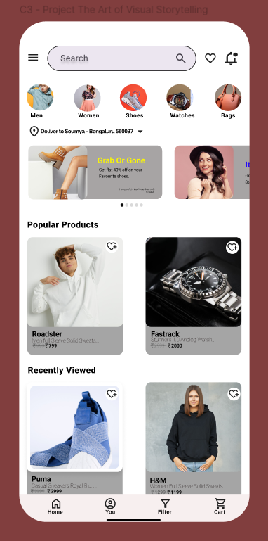
Final High-Fidelity UI

Slide 8
Typography & Color Style Guide
Font: Roboto (modern, clean look)
Colors: #F5D0D1 (BG), #7A3E3E (Accent), #000000 (Text), #FFC107 (Highlight)
Clear hierarchy using font size and weight.

Slide 9
Design Justification
Light backgrounds enhance product focus.
Deep accent color (#7A3E3E) adds brand depth.
Bold fonts guide user attention.
Carousel and cards ensure discoverability.
Consistent icons improve interaction clarity.

Slide 10
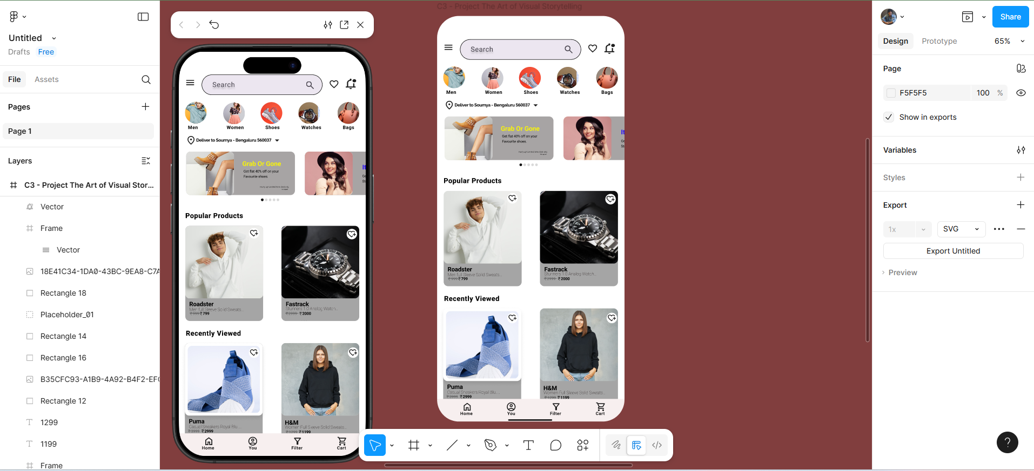
Prototype / Interactions

Slide 11
Learnings & Reflections
Improved understanding of mobile-first design.
Learned to maintain visual hierarchy and balance.
Realised the importance of user testing early.
Would explore more interaction feedback in future versions.

Slide 12
Final Conclusion
In conclusion, this e-commerce mobile UI design aims to create a seamless, visually engaging, and intuitive shopping experience for users. By focusing on mobile-first principles, we’ve simplified product discovery, enhanced visual hierarchy, and ensured ease of navigation. The choice of typography, color schemes, and layout effectively communicates the brand while maintaining user-centric functionality.
The project not only deepened our understanding of modern UI design but also highlighted the critical importance of user testing and interaction feedback in shaping successful products. As we move forward, further exploration of interactive elements and personalised experiences will enhance future versions of the design.
Thank you for your attention. I look forward to any questions or feedback you may have.

